Slide 1
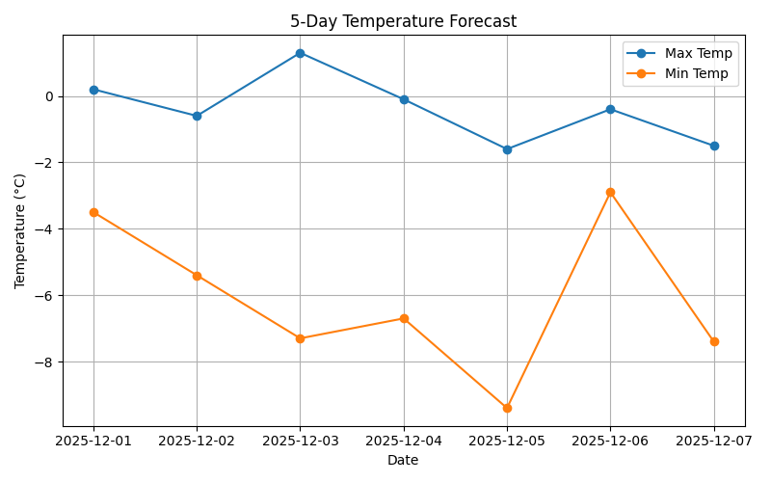


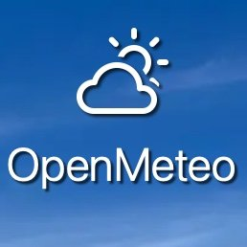

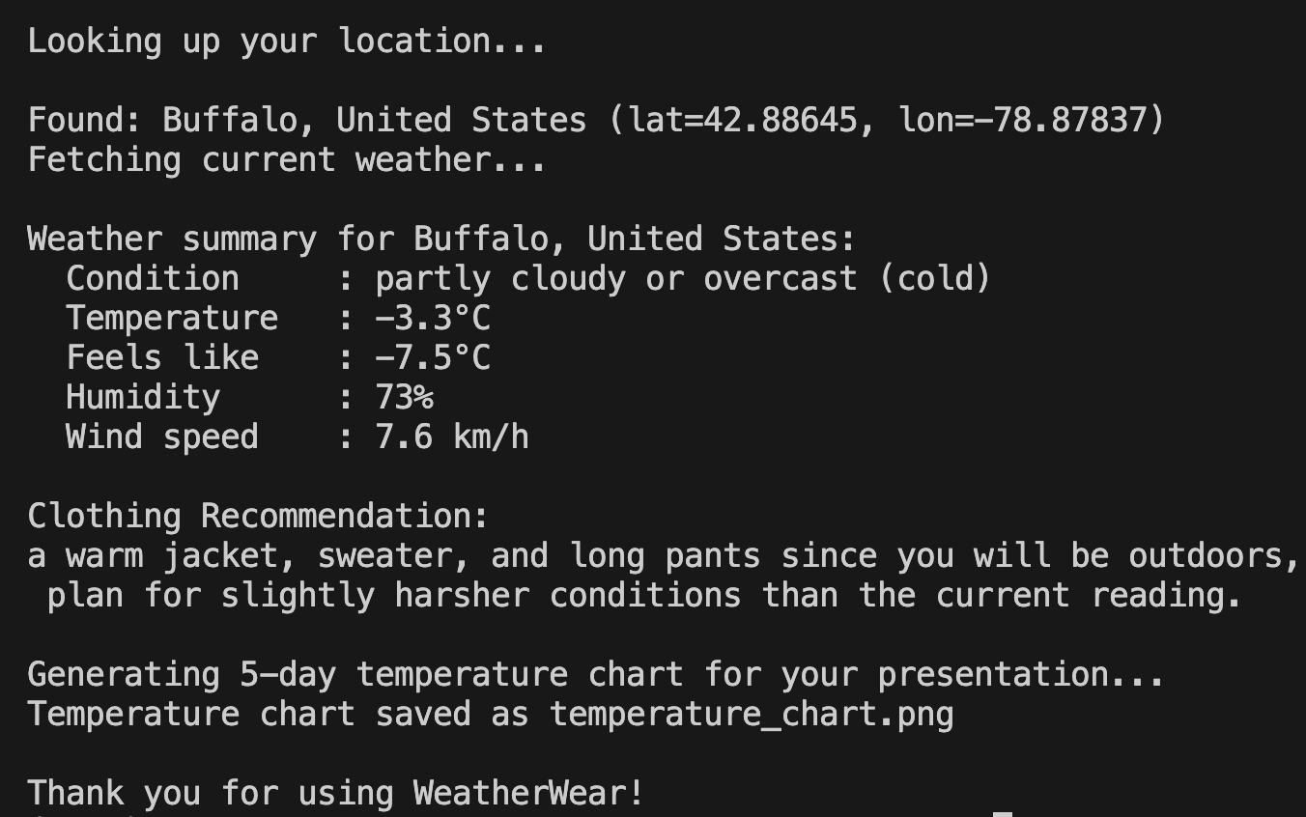
WeatherWear: Weather-Based Clothing Recommendation
Sabit Fardin, CIS 461 · Sarbani Banerjee, Ph.D. , Computer Information Systems Department
Abstract
Findings
Interpretation of Findings
WeatherWear is a Python-based intelligent clothing recommendation system that helps users choose what to wear based on real-time weather conditions. The system retrieves live meteorological data using the Open-Meteo API and analyzes temperature, humidity, wind speed, and precipitation to generate context-aware outfit suggestions for indoor or outdoor activities. The project integrates Python programming concepts, including API requests, JSON processing, conditional logic, datasets, and data visualization through Matplotlib. A 5-day temperature trend chart is also generated to enhance interpretability and demonstrate data analytics skills. WeatherWear highlights how Python can be used to solve practical, everyday problems by combining automation, data science, and user-centered design.
Key Outcomes:
Successfully retrieved and analyzed real-time weather conditions from the Open-Meteo API.
Designed a reliable recommendation engine that adapts to temperature, wind, and precipitation patterns.
Generated a clean, professional 5-day temperature trend graph for visual interpretation.
Demonstrated Python skills in APIs, logic building, datasets, and visualization.
Figures to Insert:
Screenshot of your terminal output (weather summary + recommendation).
temperature_chart.png.
Each image should include a caption such as: Figure 1. Five-day forecast temperature trend generated with Matplotlib.
Analysis of the collected data shows consistent relationships between temperature, wind speed, and clothing needs. For example, low temperatures combined with high wind speeds triggered “heavy jacket” recommendations, while moderate temperatures produced flexible layering suggestions. The 5-day forecast visualization allows users to anticipate upcoming trends rather than only reacting to same-day conditions. The preliminary results confirm that a simple rule-based model can create practical, user-friendly weather guidance without requiring machine learning—making it ideal for early-stage prototyping.
Technologies Used
Introduction
Choosing appropriate clothing can be difficult in rapidly changing weather, especially in regions with unpredictable temperature shifts, wind, or sudden rainfall. Existing weather apps report conditions but rarely offer personalized, actionable recommendations. This project bridges that gap by transforming raw meteorological data into meaningful wardrobe guidance. By integrating Python with a live weather API, WeatherWear demonstrates how students can apply computational thinking and data analysis to improve daily convenience. This project also showcases Python’s usefulness beyond academic exercises—highlighting real-world applications such as automation, data-driven decision-making, and intelligent systems.
Requests Python OpenMeteo Matplotlib
Conclusion
WeatherWear demonstrates how Python can transform raw weather data into useful, real-world recommendations. The project highlights the power of APIs, conditionals, and visualization techniques for solving daily-life problems. Future improvements may include:
Adding weekly forecasts or severe weather alerts
A mobile-friendly GUI or web interface
Custom clothing profiles (e.g., “I get cold easily”)
Machine learning for smarter predictions
WeatherWear provides a strong foundation for further development and can be scaled into a fully featured mobile or web application.
Approach
Data Acquisition: Used the Open-Meteo API for real-time weather and geocoding (lat/lon lookup).
Programming Tools: Implemented in Python using requests, json, and matplotlib.
Data Processing: Extracted current temperature, humidity, wind speed, weather conditions, and generated a 5-day forecast dataset.
Logic & Decision Engine: Developed a rule-based system considering user context (indoor/outdoor) and weather severity to determine outfit categories.
Visualization: Plotted 5-day temperature trends using Matplotlib and saved the figure as temperature_chart.png for the poster and presentation.
User Interaction: Command-line interface prompts users for city and context (indoor/outdoor), producing a personalized recommendation.
Program Output Screenshot
Acknowledgements
This project was created for CIS 461 / Python Programming under the guidance of the Computer Information Systems Department at Buffalo State University.
References
Open-Meteo API. https://open-meteo.com
Python Software Foundation. Python 3 Documentation. https://docs.python.org/3/
Matplotlib Developers. Matplotlib Documentation. https://matplotlib.org/
Requests Library. https://pypi.org/project/requests/
Buffalo State University — Poster Template Resources.

